Slide 1

Vernalis Consulting
Growth and Transformation with Harmony
Hi-Growth
Hi-Performance
Press SPACE BAR to continue

Slide 2
Introducing Vernalis
Global Presence in 6 countries
Marquee clients across sectors
20 years Track
Record of
Client Delight
Extensive experience in formulating Hi-Growth Strategies with Top Mgmt
Specialists in
Hi-Growth
& Hi-Performance Transformation
Unique approach of Orchestrating Org Transformation thru Consensus and Harmony
World Class
Management Consulting Firm
Press SPACE BAR to continue

Slide 3


Key Services
`
Vernalis Consulting
Hi-Performance Architecture
Creating Resurgent Organisations
Breakthru Vision
Energising Leadership
Strategy for Breakthru
L&D Framework & Pathways
HR
Excellence
Hi-Growth
Competency
Mapping & Dev
Strategic HR
Strategy
Cascading
Leadership Assessment & Development
Hi-Performance
CXO
Selection
Org
Diagnosis
Sr. Exec.
Coaching
Strategy
Implementation
Hi-Perf.
Conversations
Org
Restructuring
Energising Research
& Innovation
Value Added
Hierarchy
Performance
Maxima
Press SPACE BAR to continue

Slide 4
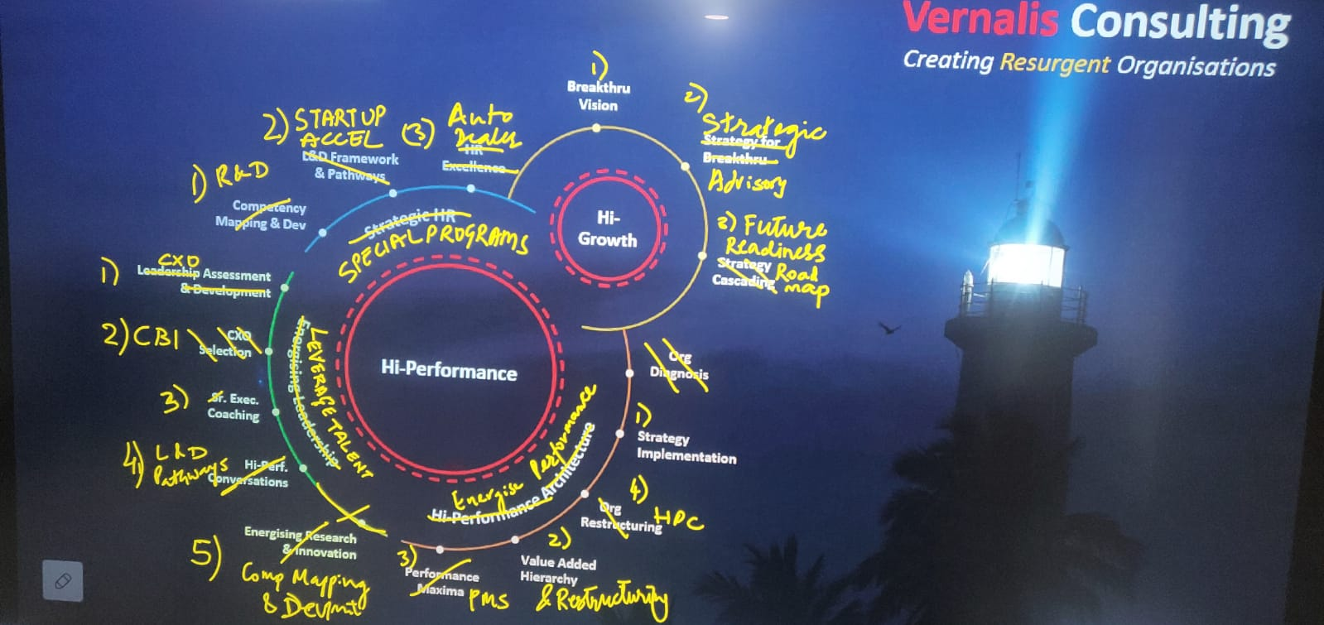
Suggested Modifications – BG Review Pending

Slide 5





























Vernalis Clients
v e r n a l i s c o n s u l t i n g . c o m

Slide 6

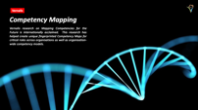

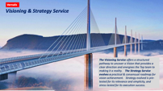

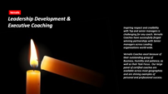



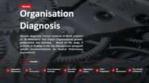



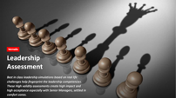




Vernalis Services

Slide 7

Vernalis
Visioning & Strategy Service
The Visioning Service offers a structured pathway to uncover a Vision that provides a clear direction and energises the Top team to making it a reality. The Strategy Service evolves a practical & consensual roadmap for vision achievement. Strategy evolved is pre-tested for its relevance and simplicity, and stress tested for its execution success.

Slide 8

Vernalis
Organisation Diagnosis
Vernalis diagnostic Service conducts in-depth research on 38 dimensions that impact Organisational growth, performance and harmony. Based on the study, it presents its findings to the Top Management alongwith specific recommendations for Radical Performance Improvement.
Reports Included
1
Organisation
Effectiveness
2
Hi-
Performance
3
Future Readiness
Roadmap
4
Pain Points
Heatmap
Organisation
Culture
Talent
Engagement
HR
Effectiveness
Org. Strength
& Weakness
5
6
7
8

Slide 9

`
Vernalis
Value Added Hierarchy
Vernalis has discovered simple practical and extremely effective methods to reinvigorate focus and radically improve organisational productivity. Value Added Hierarchy initiative, aligns the entire organisation to Top Management Vision and strategy, resulting in an explosive increase in focus and productivity and much higher employee satisfaction scores.

Slide 10

Vernalis
Leadership
Assessment
Best in class leadership simulations based on real life challenges help fingerprint the leadership competencies. These High validity assessments create high impact and high acceptance especially with Senior Managers, settled in comfort zones.

Slide 11


Vernalis
CX
Vernalis
Right
A premium offering that facilitates critical CXO level recruitment decisions. Delivers High ROI and builds great credibility among participants.
Selection

Slide 12

Vernalis
Leadership Development & Executive Coaching
Inspiring respect and credibility with Top and senior managers is challenging for any coach. Vernalis Coaches have successfully forged winning partnerships with Senior managers across Leading organisations world-wide.
Vernalis Coaches excel because of their outstanding grasp of Business, Humility and patience, as well as their Task Focus. Our large panel of certified coaches are available across most geographies and are shining examples of personal and professional success.

Slide 13
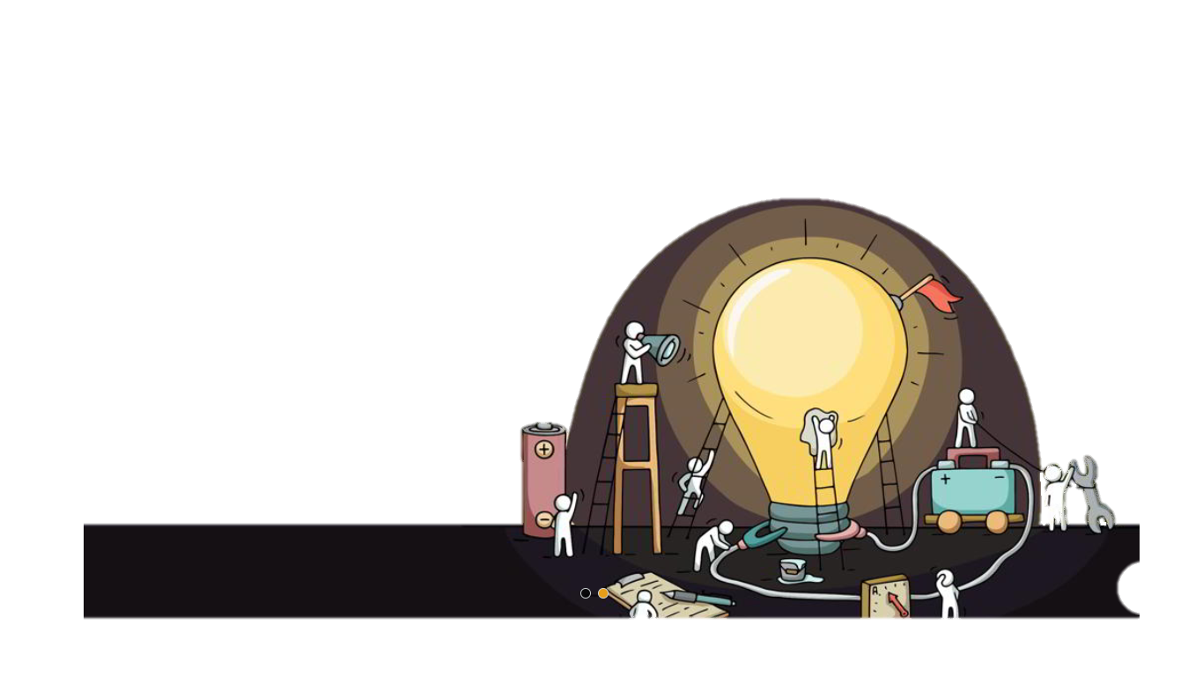
Vernalis
Energising Research & Innovation
Success in Research and Product Development can make or break organisations. However, the Complexity of Product Development programs including Challenges of design innovation, Costs, people competence can be a nightmare to manage.
Vernalis has helped organisations manage the complexity and challenges of product development by guiding them in every step of the journey from setting-up the program to sustainable success.

Slide 14

Vernalis
Competency Mapping
Vernalis research on Mapping Competencies for the Future is internationally acclaimed. This research has helped create unique fingerprinted Competency Maps for critical roles across organisations as well as organisation-wide competency models.

Slide 15


Additional Services
Vernalis
Click to know more…

Slide 16













Additional Services
Culture
Change
Harnessing
Digital
Change
Facilitation
HR
Excellence
Auto Dealer
Dev Program
Competency
Based Interview
360
Degree
L&D Framework
& Pathways
Hi-Performance
Conversations
Assessor
Training
Performance
Mgmt System
Future
Leaders

Slide 17


Additional Services
Culture
Change
Harnessing
Digital
Change
Facilitation
HR
Excellence
Future Readiness
Roadmap
Auto Dealer
Dev Program
Competency
Based Interview
360
Degree
L&D Framework
& Pathways
Open Assessments
Hi-Performance
Conversations
Assessor
Training
Performance
Mgmt System
Future
Leaders
Future
Leaders

Slide 18






Additional Services
HR Effectiveness
Survey
CBI
360

Slide 19
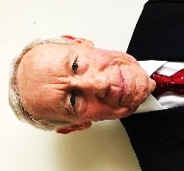
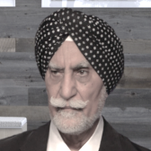
CEO Testimonials
Terry Moffat
Chairman
ETEK
Our Engagement with Vernalis yielded results beyond my highest expectations. I am confident that Etek is now on the path to rapid growth and high profitability aiming to become the leading Cybersecurity company in Latin America.
Ravi Chopra
Chairman
Piaggio
My in-depth interactions with the Vernalis team have been very meaningful. Their findings have enabled the management to identify strategic initiaves to become a World Class Organisation

Slide 20
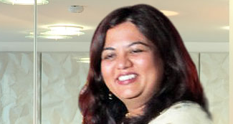

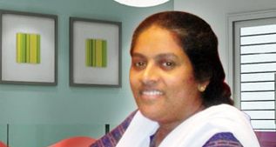
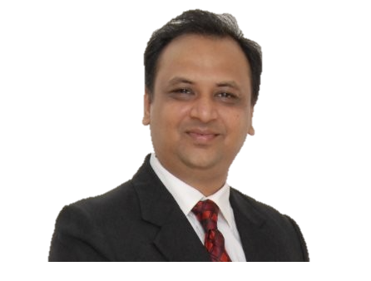
Vernalis Expertise | Client Testimonials – Project Sponsors
HR Head, MaxBupa Life
Head, People Developmt, Audi
VP HR, TCS
Anupama
Garg
Shalin Kadikar
Sindhu John
Vernalis Partnered us in developing our Leadership Pipeline. At the end of the Year long program, we got better than expected results and most people delivered superior performance at the co. I was left inspired by the dedication and superlative quality of Vernalis.
Vernalis has been associated with Audi India since last 6 years. Their profound understanding and craft of conducting an assessment is insightful and comes with deep rooted practice of the nuances. A very well oiled team which is seamlessly aligned to goals and objectives. Audi has benefitted greatly from their skill and is continuously using their services.
We chose Vernalis for our ADCs due to their focus on Fairness and Quality. Post ADC, many participants spoke about the program’s contribution towards their self and professional development. Overall, the value addition that Vernalis brings in the process is admirable.

Slide 21
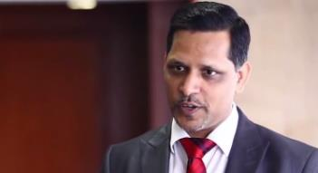
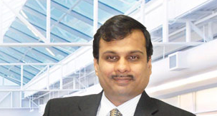
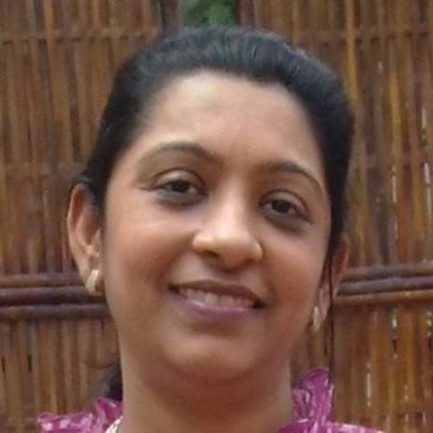

Vernalis Expertise | Client Testimonials – Program Participants
VP HR, GE- SBI Cards
VP HR, PIAGGIO
ISU HR Head, TCS
Avadhesh Dixit
Mangesh
Kulkarni
Dr Komal Mathur
Vernalis coaching program is one of the best developmental intervention I have experienced in many years… very competent faculty & coaches… highly engaging, interactive and offered valuable insight into human behaviour. Precise diagnosis and personal customized feedback makes the programs very effective. Learnings are easily transferrable at work place.
I had six wonderful days. Got objective feedback on what I am with specific development actions. In key areas like People Development and Decision Making, there was a significant change in me, acknowledged even by my boss. Today even 5 years later I feel immensely benefitted. All should go through this program
Well designed & executed. The Vernalis program had a metrics driven approach at every stage of the process and made it easy to identify + accept + work on my areas for improvement

Slide 22

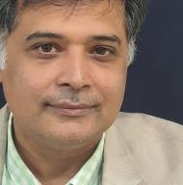
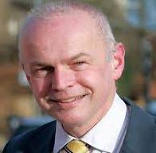

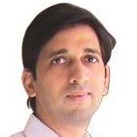


Vernalis Team
Bharat Grover
Mark Argent
Gabby Hartin
Abhijit Bhabhe
Mumbai, India
London, UK
Melbourne, Australia
Mumbai, India
Founding Partner at Vernalis, Bharat has impacted many CEOs with his deep questions, his integrity and his insights into human behaviour.
Founder, Mark Argent Consulting, Mark is a very gentle and much in demand global facilitator. He is multi-faceted with expertise in many areas and strong spiritual foundation.
CEO & Founder at Higher Curve, Gabby brings energy and earthy wisdom to every situation. Certified from leading institutions, Gabby has over 20 years of experience in coaching assignments.
Founding Partner at Vernalis, Abhijit is an outstanding listener, a patient and keen observer and a perfect match for CEOs seeking to discipline and balance themselves with objective feedback.
For detailed profiles, write to rakesh.mehta@vernalis.in

Slide 23
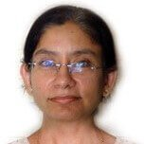
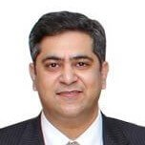
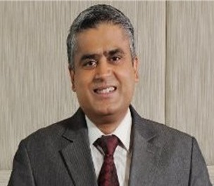
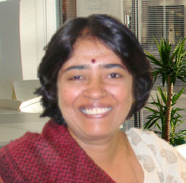
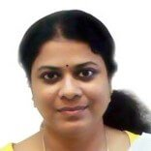
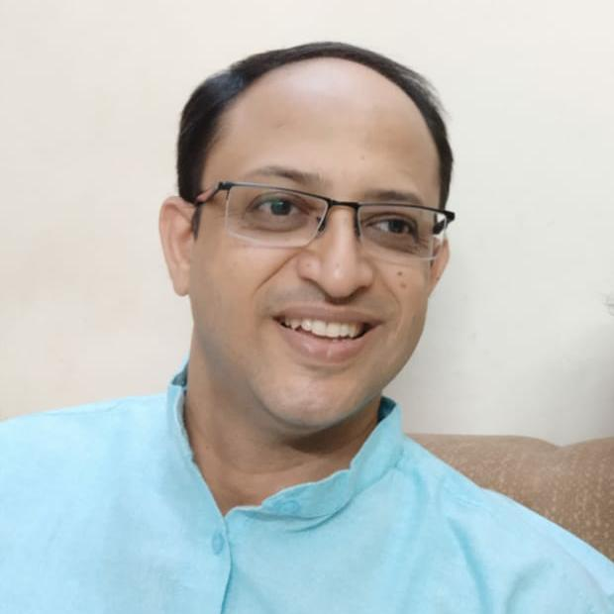
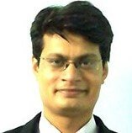
Vernalis Team
Indu Bilaney
Vivek Kaul
Jaideep Nikam
Sridevi Rao
Mumbai, India
Mumbai, India
KL, Malaysia
Hyderabad, India
Gayathri S.
Rajesh Trivedi
Rakesh Mehta
Mumbai, India
Mumbai, India
Mumbai, India
For detailed profiles, write to rakesh.mehta@vernalis.in

Slide 24

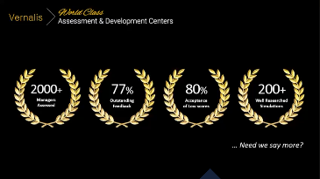

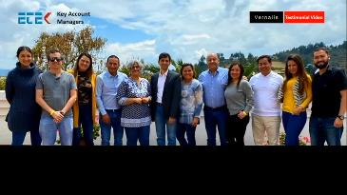
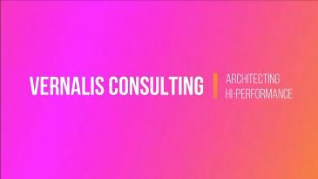

Video Testimonials

Slide 25







c o n n e c t @ v e r n a l i s c o n s u l t i n g . c o m
Vernalis Consulting
w w w . v e r n a l i s c o n s u l t i n g . c o m
Write to us : connect@vernalisconsulting.com
Growth &
Transformation
with Harmony
Global Presence
Corporate Office
6C3 Gundecha Enclave, Kherani Road, Mumbai, INDIA 400072
India
USA
UK
Colombia
Malaysia
Bahrain

